Slide 1
Mountianboard - Lesson 3
Basic Parts – The Binding
School’s Name
Teacher’s Name
Date

Slide 2
Features and Commands
Base Feature
The first feature that is created.
The foundation of the part.
The base feature geometry for the box is an extrusion.
The extrusion is named Extrude1.
Tip: Keep the base feature simple.

Slide 3
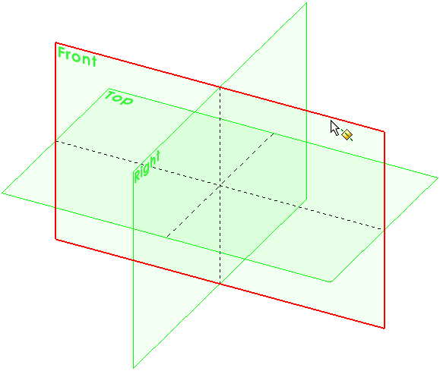
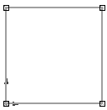
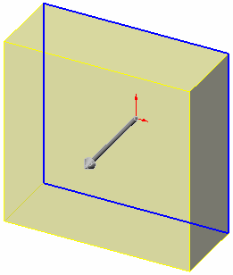
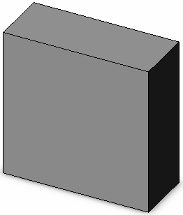
To Create an Extruded Base Feature:
Select a sketch plane.
Sketch a 2D profile.
Extrude the sketch
perpendicular to
sketch plane.
Select the sketch plane
Sketch the 2D profile
Extrude the sketch
Resulting base feature

Slide 4
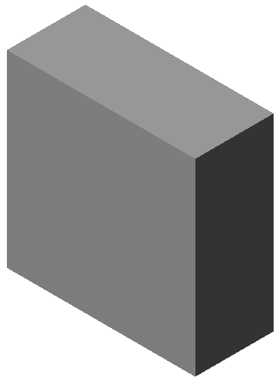
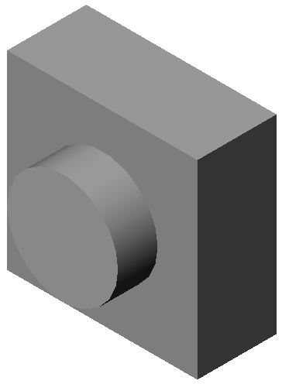
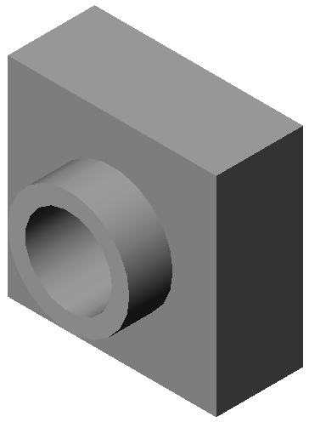
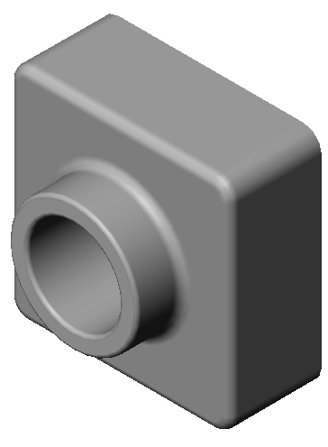
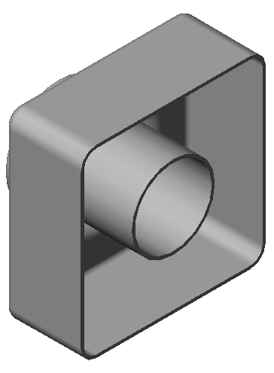
Features Used to Build Tutor1
1.Base Extrude
2.Boss Extrude
3.Cut Extrude
4.Fillets
5.Shell

Slide 5
Features Used to Build Tutor1
Extruded Boss Feature
  Adds material to the part.
  Requires a sketch.
Extruded Cut Feature
  Removes material from the part.
  Requires a sketch.
Fillet Feature
  Rounds the edges or faces of a part to a specified radius.

Slide 6
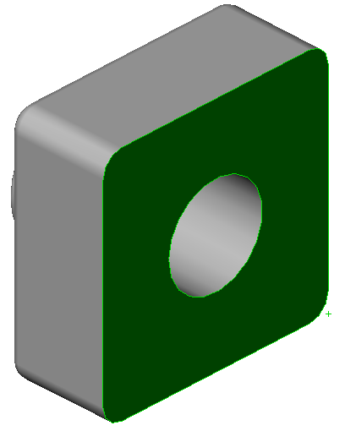
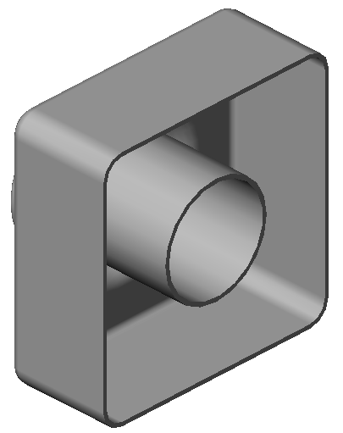
Features Used to Build Tutor1
Shell Feature
  Removes material from the selected face.
  Creates a hollow block from a solid block.
  Very useful for thin-walled, plastic parts.
  You are required to specify a wall thickness when using the shell feature.

Slide 7
View Control
Magnify or reduce the view of a model in the graphics area.
Zoom to Fit – displays the part so that it fills the current window.
Zoom to Area – zooms in on a portion of the view that you select by dragging a bounding box.
Zoom In/Out – drag the pointer upward to zoom in. Drag the pointer downward to zoom out.
Zoom to Selection – the view zooms so that the selected object fills the window.

Slide 8
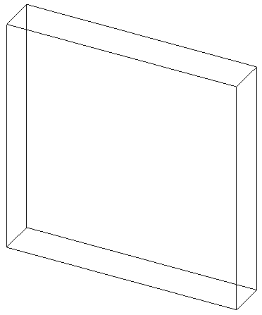
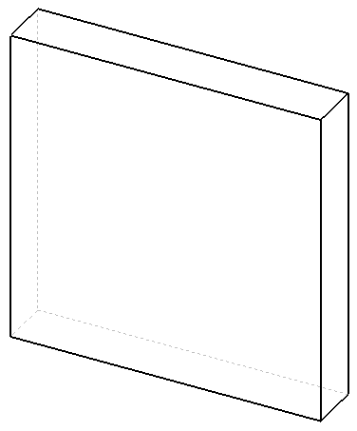
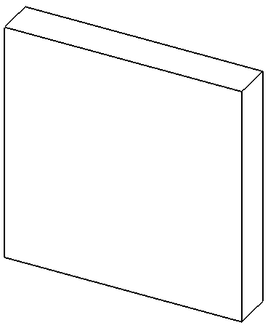
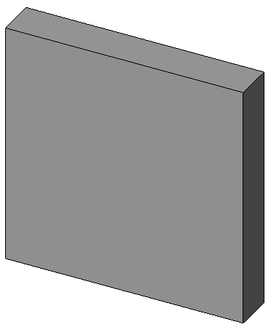
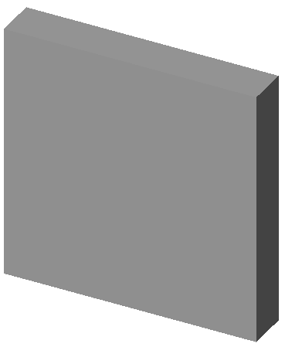
Display Modes
Illustrate the part in various display modes.
Wireframe
Hidden lines
Visible
Hidden Lines
Removed
Shaded With
Edges
Shaded

Slide 9
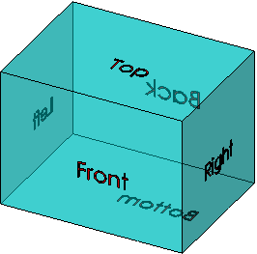
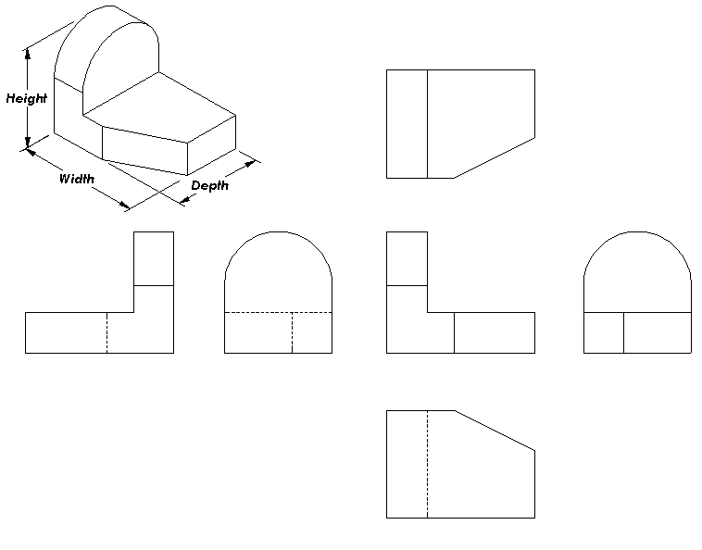
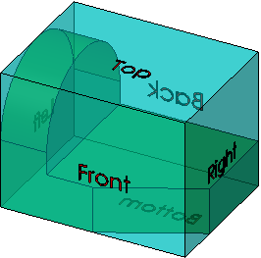
Standard Views
Isometric
View
Top View
Back View
Left View
Front View
Right View
Bottom View

Slide 10
View Orientation
Changes the view display to correspond to one of the standard view orientations.
Front
Right
Bottom
Isometric
Top
Left
Back
Normal To
(selected plane
or planar face)

Slide 11
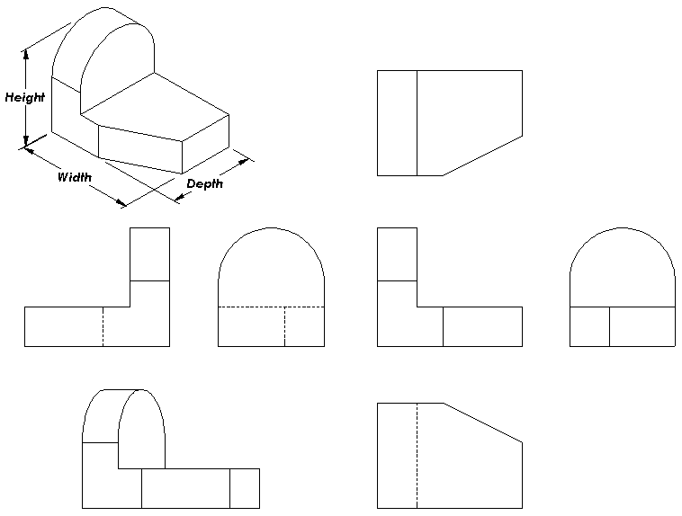

Slide 12
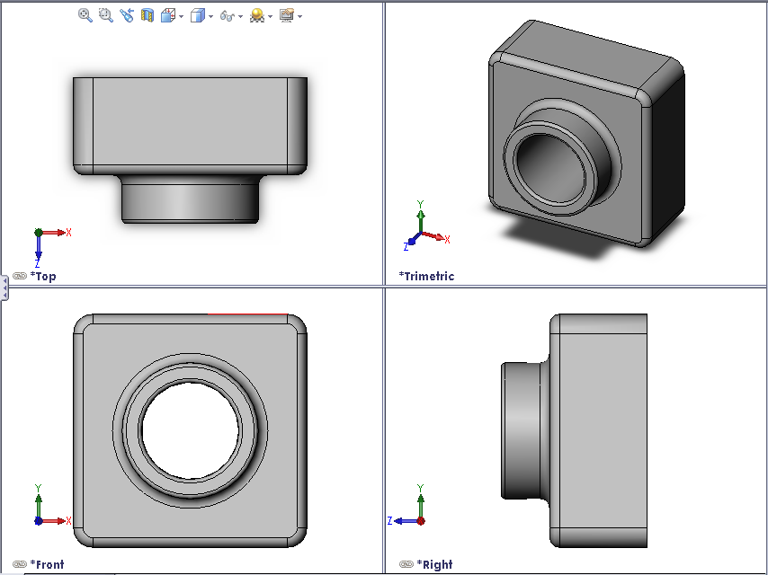
View Orientation
The views most
commonly used
to describe a
part are:
  Top View
  Front View
  Right View
  Isometric View

Slide 13
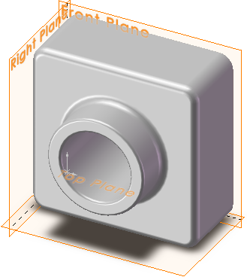
Default Planes
Default Planes
  Front, Top, and Right
Correspond to the
standard principle
drawing views:
  Front = Front or Back view
  Top = Top or Bottom view
  Right = Right or Left view

Slide 14
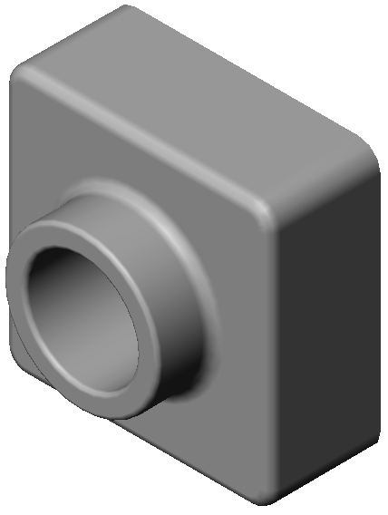
Isometric View
Displays the part with height, width, and depth equally foreshortened.
  Pictorial rather than orthographic.
  Shows all three dimensions –
  height, width, and depth.
  Easier to visualize than
  orthographic views.

Slide 15
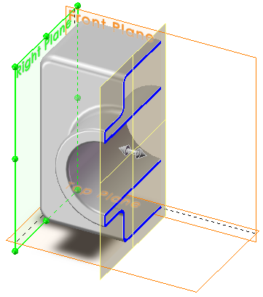
Section View
Displays the internal structure of a model.
Requires a section
cutting plane.
Section Plane

Slide 16
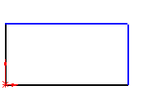
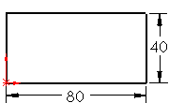
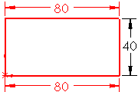
The Status of a Sketch
Under defined
  Additional dimensions or relations
  are required.
  Under defined sketch entities are
  blue (by default).
Fully defined
  No additional dimensions or relationships
  are required.
  Fully defined sketch entities are
  black (by default).
Over defined
  Contains conflicting dimensions or
  relations, or both.
  Over defined sketch entities are
  red (by default).

Slide 17
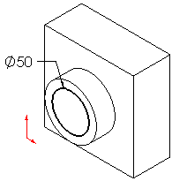
Geometric Relations
Geometric relations are the rules that control the behavior of sketch geometry.
Geometric relations help capture design intent.
Example: The sketched circle is concentric with the circular edge of the extruded boss feature.
In a concentric relation, selected
entities have the same center point.

Slide 18
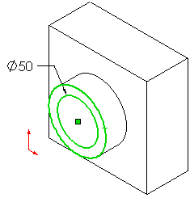
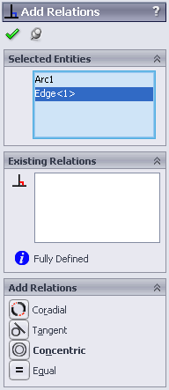
Geometric Relations
The SolidWorks
default name for
circular geometry
is an Arc#.
SolidWorks treats circles as 360° arcs.

Slide 19
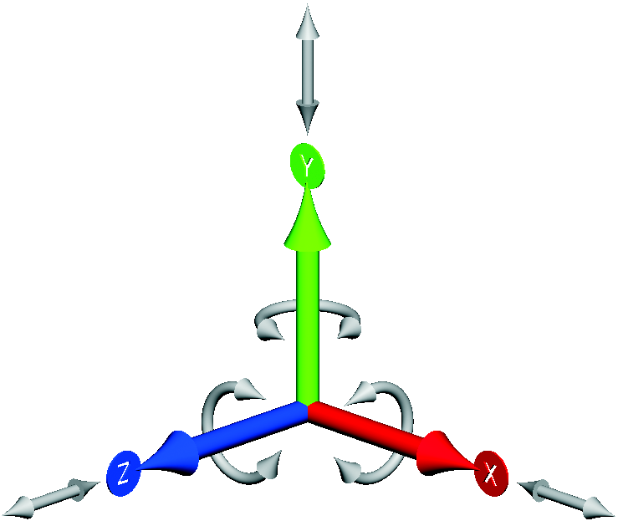
Degrees of Freedom: There are Six
They describe how an object is free to move.
Translation (movement) along X, Y, and Z axes.
Rotation around X, Y, and Z axes.

Slide 20
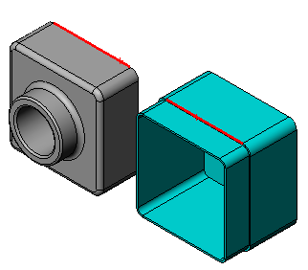
Mate Relationships
Mates relationships align and fit together components in an assembly.
The Tutor assembly requires three mates to fully define it.
The three mates are:
Coincident between the top
back edge of Tutor1 and
the edge of the lip on Tutor2.
Edges
Tutor1
Tutor2

Slide 21
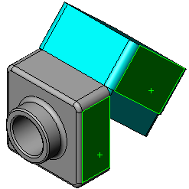
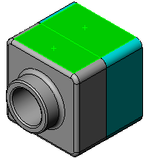
Mate Relationships
Second Mate: Coincident
mate between the right face
of Tutor1 and the right face
of Tutor2.
Third Mate: Coincident mate
between the top face of
Tutor1 and the top face
of Tutor2.

Slide 22
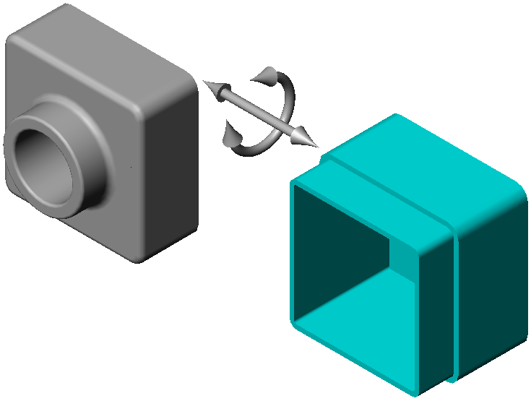


Mates and Degrees of Freedom
The first mate removes all but two degrees of freedom.
The remaining degrees of freedom are:
  Movement along the edge.
  Rotation around the edge.

Slide 23
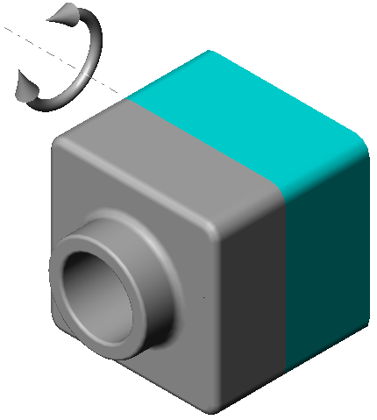
Mates and Degrees of Freedom
The second mate removes one more degree of freedom.
The remaining degree of freedom is:
  Rotation around the edge.

Slide 24
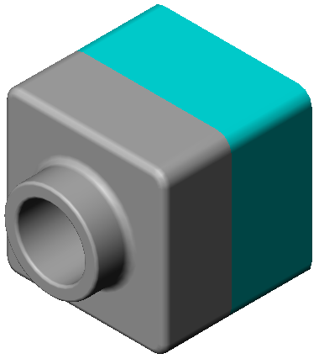
Mates and Degrees of Freedom
The third mate removes last degree of freedom.
No remaining degrees of freedom.
The assembly is fully defined.

Slide 25
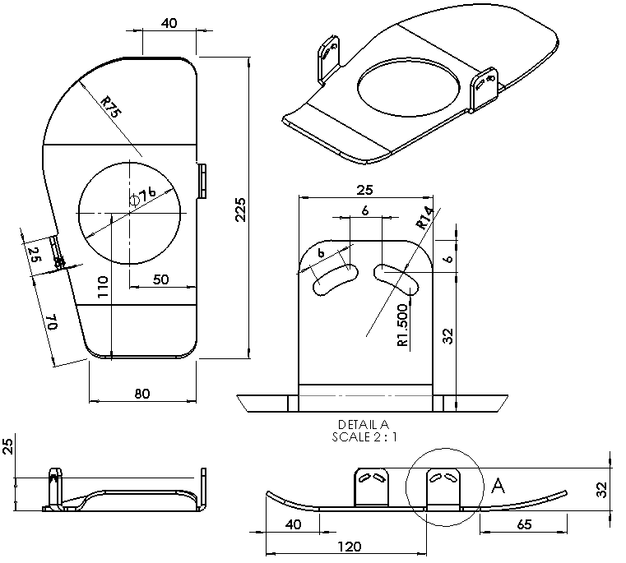
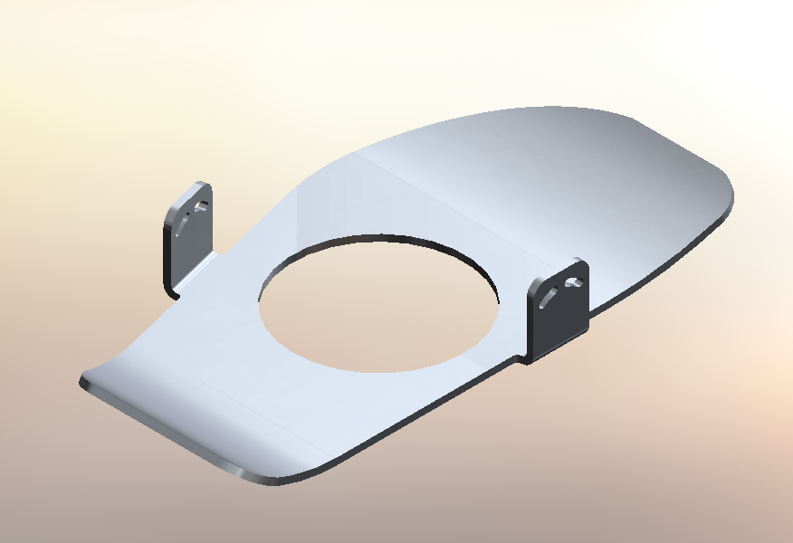
Binding Base Plate

Slide 26
Design Intent
There will be two versions: left foot and right foot
Binding will be held in place by the Binding Anchor
The front and back (toe and heel ends) will curve upward
Side tabs will help to hold the foot centered
Side tabs will have slots to attach the flexible straps that go over the foot

Slide 27
Manufacturing
Part will be cut from flat piece and bent to final shape
Use sheet metal functions to create a flat pattern

Slide 28
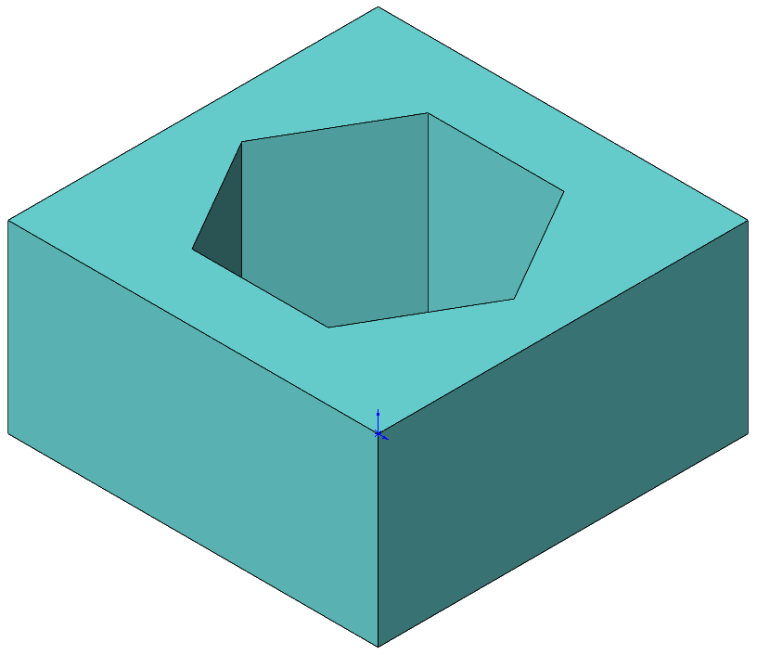
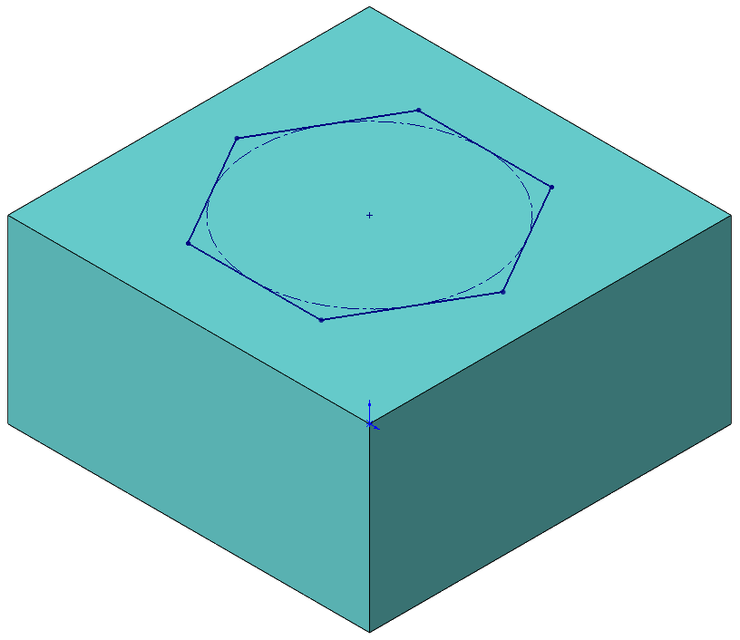
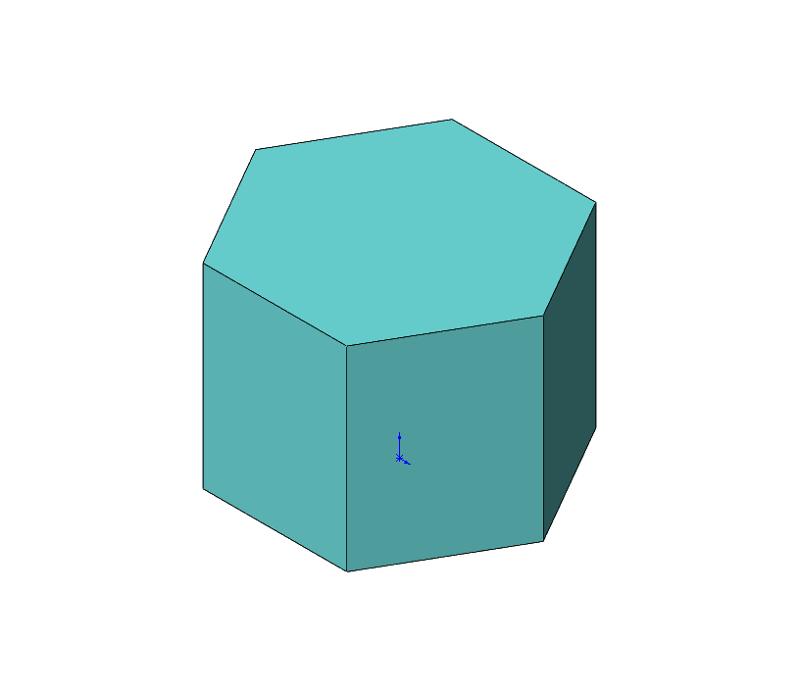
Flip Side To Cut
An Extruded Cut can remove either the material inside or outside the sketch
Sketch

